Slide 1

Unboxing Cyber Risk from Theory to Practice
Jiorgos Miskakis, EvidentScientific EMEA CISO

Slide 2
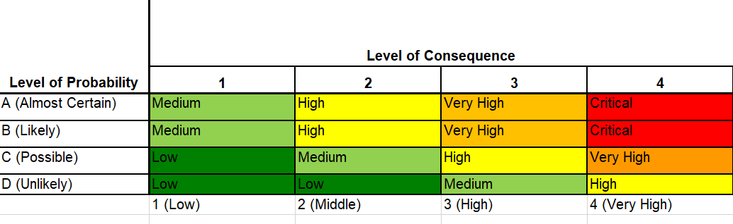
A qualitative risk assessment is Basically:
A long questionnaire with information security ISMS questions or XYZ Framework
Likelihood and Impact/Consequences are subjective given
Treatment plan includes high level statements

Slide 3



Which leads to the Problem of:
Explanation needed
Questionable
Lengthy ….. discussions

Slide 4
What IF, there is A Framework based on controls, efficiency and risk scenarios that can reduce challenges

Slide 5

Framework Design Principles
Context-Based Scenarios – Tailor risks to business needs.
Asset Prioritization (Triage) – Identify and classify critical assets.
Control Mapping
Efficiency in Controls – Measurable controls (e.g., patch cadence, response time).
Risk Categorization

Slide 6
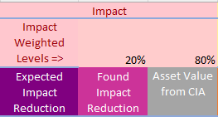
Impact Dimension is a weighted combination of:
The Asset Value based on the Confidentiality, Integrity and Availability
Expected Controls that can reduce impact VS controls that exist

Slide 7
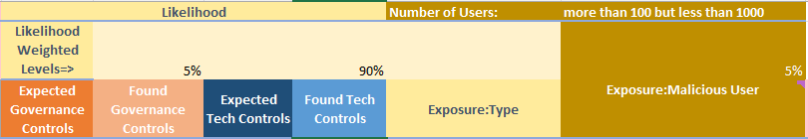
Likelihood Dimension is a weighted combination of:
Governance controls, e.g Document Policies
Technical controls implemented VS expected

Slide 8
Triage example 1
Confidentiality
5-Top Secret, e.g PII, Intellectual Property, blueprints
4-Confidential
Integrity
5-It requires the strictest controls to prevent unauthorized access, modification, or tampering
3-Data at this level is less sensitive and can tolerate a certain degree of modification or inadvertent errors. E.g build process
Availability
5-Max. 2h outage
3-Up to 8h
1-Public
1-Is not relevant, e.g synthetic random data
1-Can remain down till someone will decide otherwise
4-Max. 4h outage
2-Up to 12h

Slide 9
Triage example 2
Confidentiality
5-Top Secret, e.g PII, Intellectual Property, blueprints
4-Confidential
Integrity
5-It requires the strictest controls to prevent unauthorized access, modification, or tampering
3-Data at this level is less sensitive and can tolerate a certain degree of modification or inadvertent errors. E.g build process
Availability
5-Max. 2h outage
1-Public
1-Is not relevant, e.g synthetic random data
Distribution
5-Global locations, multiple admins
3-Less than 3 countries, multiple users
1-Small userbase in one single country
4-Max. 4h outage
3-Up to 8h
2-Up to 12h
1-Can remain down till someone will decide otherwise

Slide 10
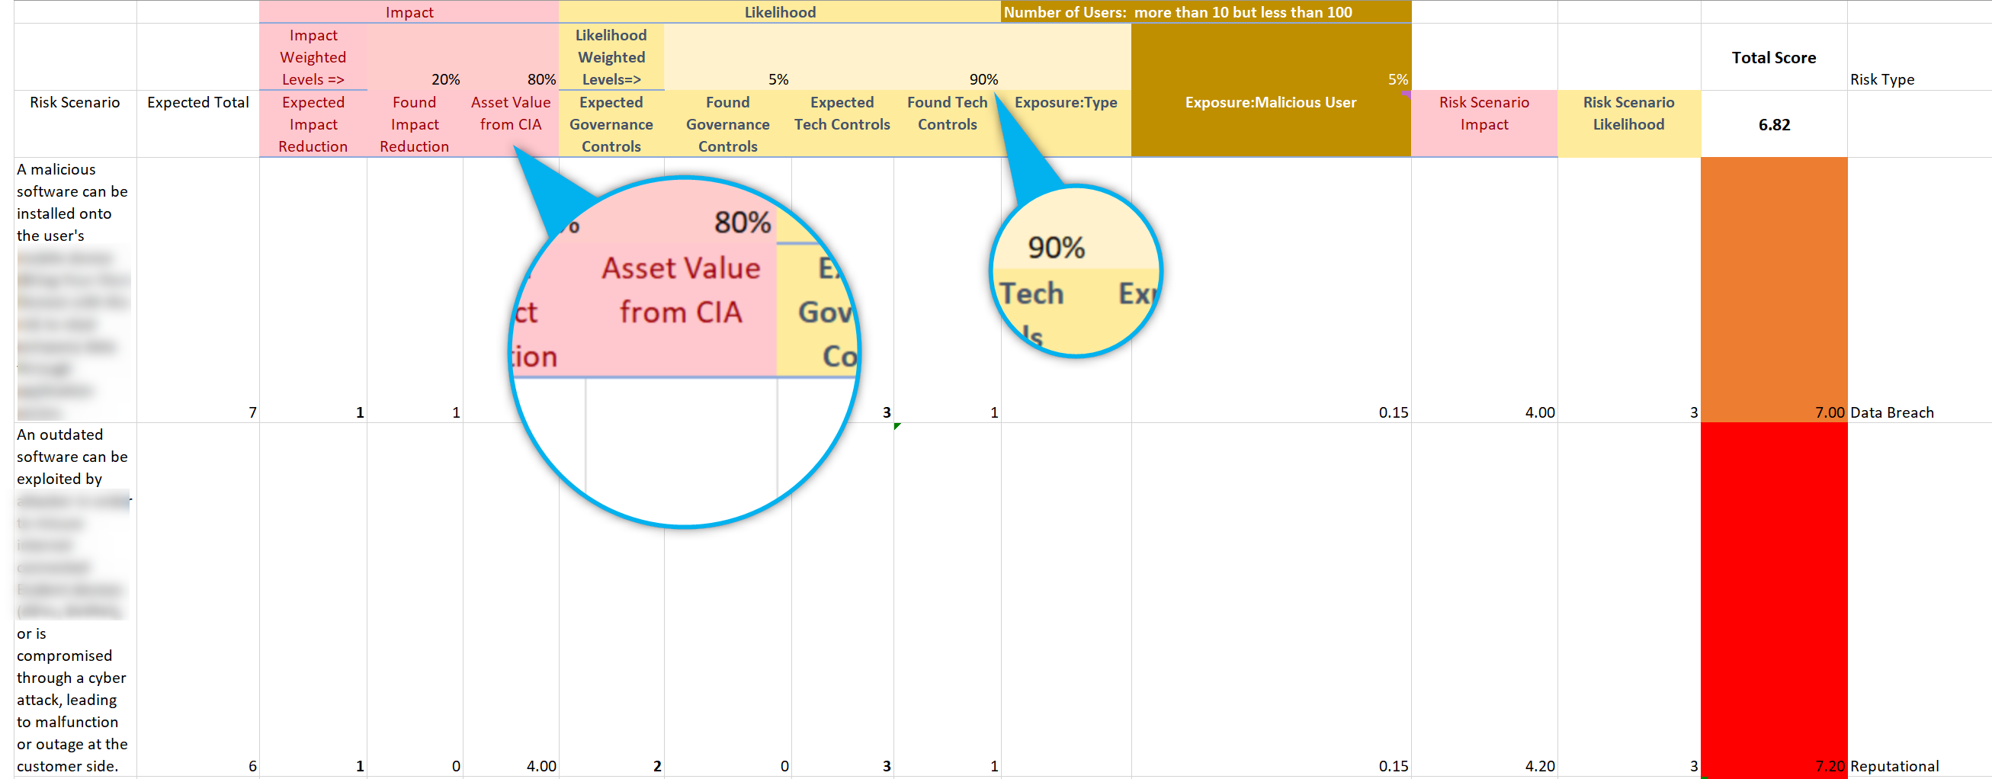
Execute (example)

Slide 11
Key Takeaways
Simplifies interactions with intuitive, accessible questions
User-Friendly
Time Considerations
Complexity Is Hidden
Tech Agnostic

Slide 12
Key Takeaways
Scenario creation is time consuming and needs feedback from multiple stakeholders
User-Friendly
Time Considerations
Complexity Is Hidden
Tech Agnostic

Slide 13
Key Takeaways
Providing the enduser an easy to understand story
Controls statements, or mapping to various Security frameworks can be done in background
User-Friendly
Time Considerations
Complexity Is Hidden
Tech Agnostic

Slide 14
Key Takeaways
The framework can be applied from spreadsheets to web UI’s and it is not tighten to a specific product or vendor
User-Friendly
Time Considerations
Complexity Is Hidden
Tech Agnostic

Slide 15


Download
Thank you!
Jiorgos Miskakis
https://www.linkedin.com/in/miskakis/
ISACA CISM,CISA,CDPSE,CRISC,
PECB ISO27K Auditor&Implementer,
ITIL v3

